Slide 1
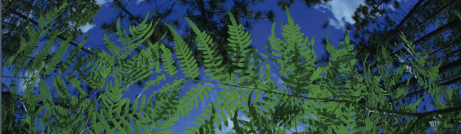

Using Digitized Specimen Data in Research: Applications for Ecology, Phylogenetics, and Biogeography
Pam Soltis
University of Florida
BiotaPhy

Slide 2
Topics
Downloading data
Georeferencing
GEOLocate
Ecological Niche Modeling
Maxent
ENM Analysis & Interpretation
Phylogenetic Diversity
Linking to phylogeny - BiotaPhy
Additional uses of collections data
Notes:
BASED ON THE RESULTS OF THE SURVEY, THE TOP CHOICES OF TOPICS HAD TO DO WITH ECOLOGICAL NICHE MODELING AND LINKING TO PHYLOGENY, SO WE HAVE SET UP THE DAY IN SUPPORT OF THESE ACTIVITIES. We will start with the three activities at the top—download data, georef, and niche modeling using Maxent
and then PD and BiotaPhy, WHICH IS A PLATFORM FOR LINKING SPECIMEN RECORDS IN IDIGBIO WITH PHYLOGENIES IN THE OPEN TREE OF LIFE AND NICHE MODELING USING LIFEMAPPER. EVERYTHING AFTER ENM IS IN THE PM.

Slide 3


Workshop Leaders
Pam Soltis
Doug Soltis
Shelly Gaynor
Maria Cortez
Andre Naranjo
Lauren Whitehurst
BiotaPhy
Notes:
BASED ON THE RESULTS OF THE SURVEY, THE TOP CHOICES OF TOPICS HAD TO DO WITH ECOLOGICAL NICHE MODELING AND LINKING TO PHYLOGENY, SO WE HAVE SET UP THE DAY IN SUPPORT OF THESE ACTIVITIES. We will start with the three activities at the top—download data, georef, and niche modeling using Maxent
and then PD and BiotaPhy, WHICH IS A PLATFORM FOR LINKING SPECIMEN RECORDS IN IDIGBIO WITH PHYLOGENIES IN THE OPEN TREE OF LIFE AND NICHE MODELING USING LIFEMAPPER. EVERYTHING AFTER ENM IS IN THE PM.

Slide 4
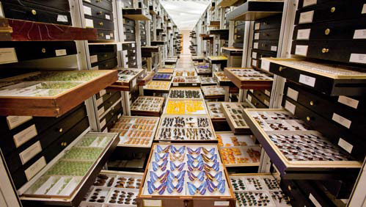
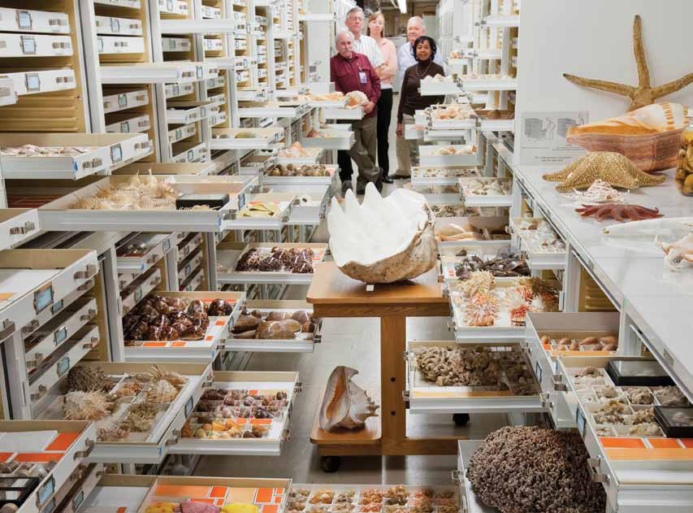
Museum Collections
~1,600 natural history collections
in the US
1-2 billion specimens
in the US
3-4 billion specimens worldwide
Smithsonian
Notes:
Wealth of data associated with collections worldwide

Slide 5
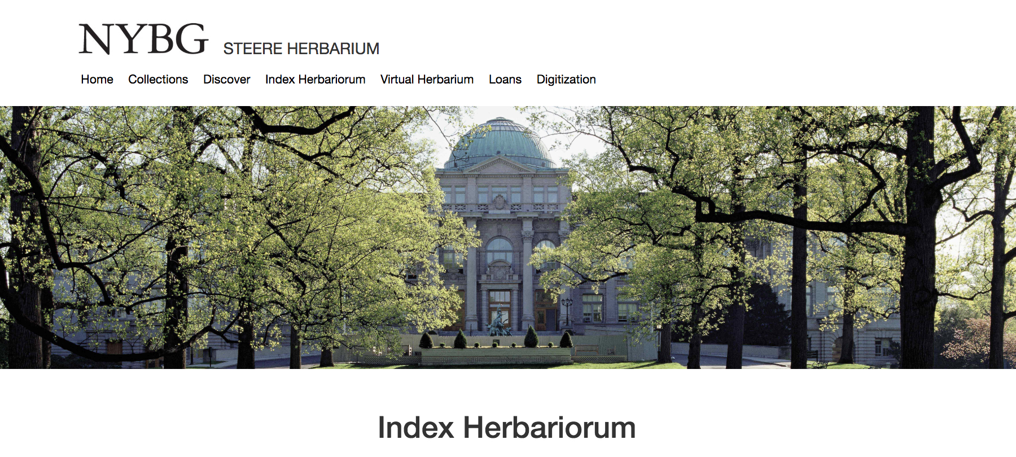
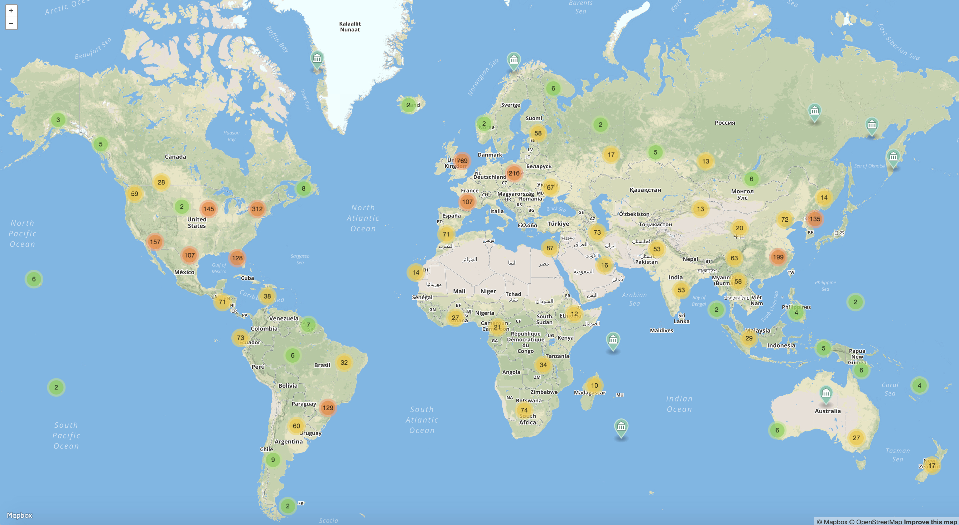
Herbaria
3,400 herbaria
400,000,000 specimens!
Thiers 2020
Notes:
Wealth of data associated with collections worldwide

Slide 6


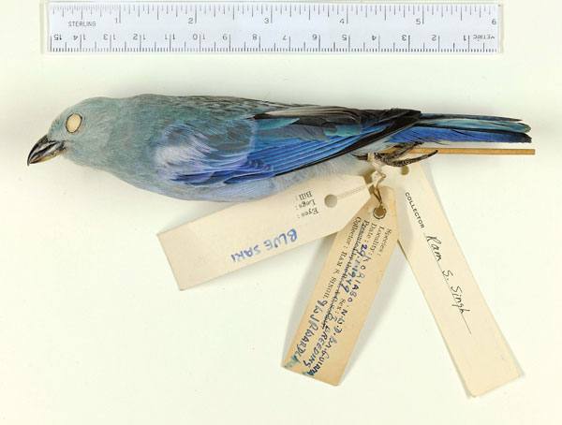
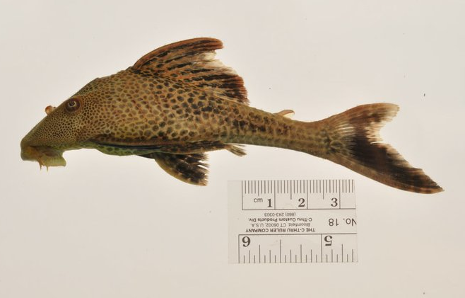
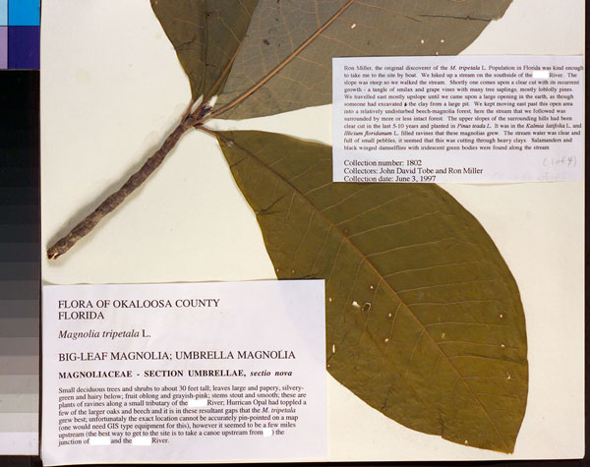
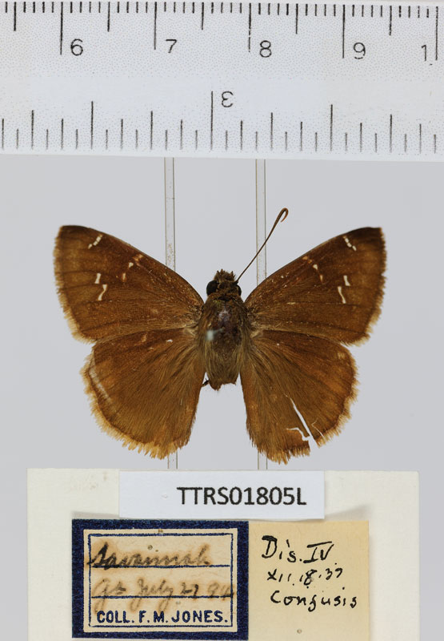
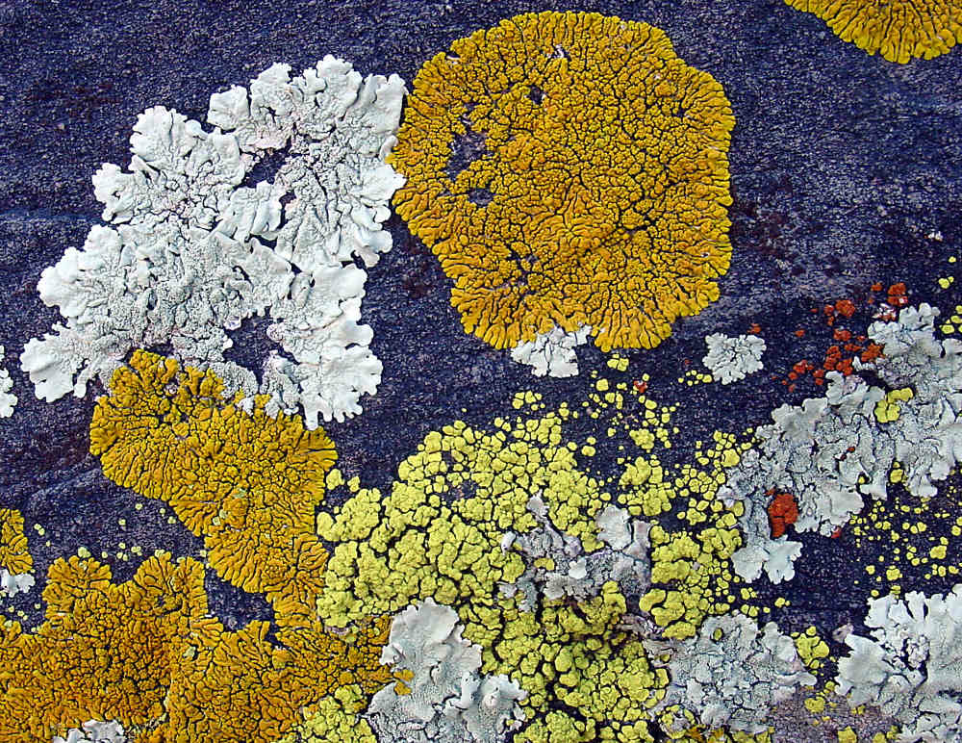
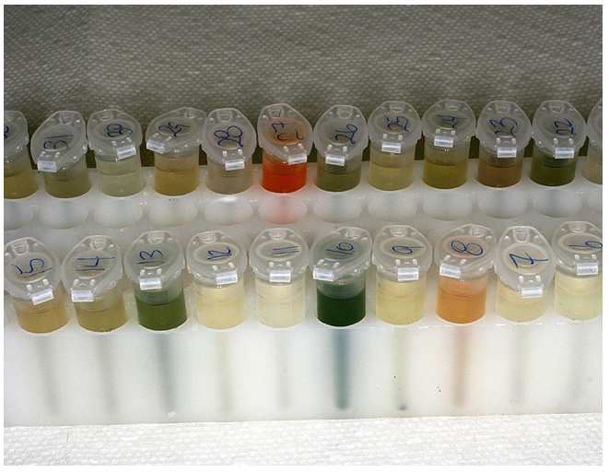
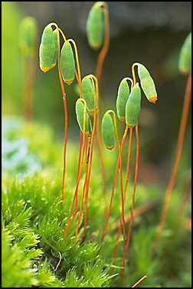
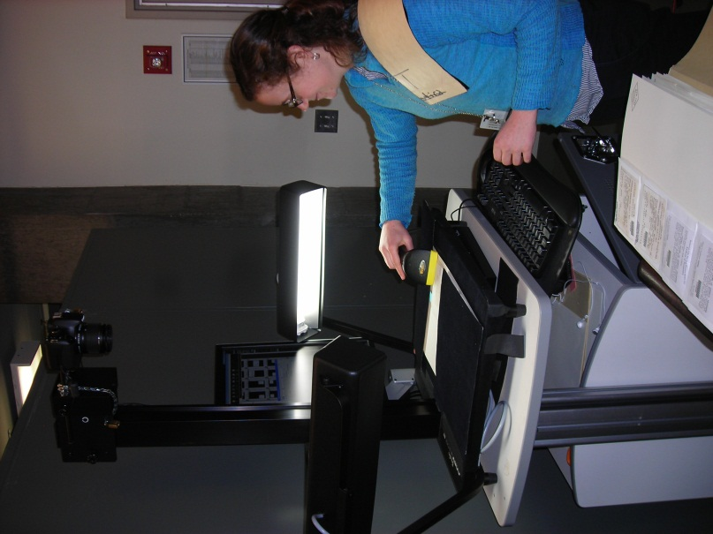
iDigBio: www.idigbio.org
National Coordinating Center
For Digitization of Biodiversity Collections
Ingest, serve, integrate data:
Localities
Dates
Images
Notes:
Harnessing these data—the goal of idigbio. Collab between arch rivals UF FSU

Slide 7
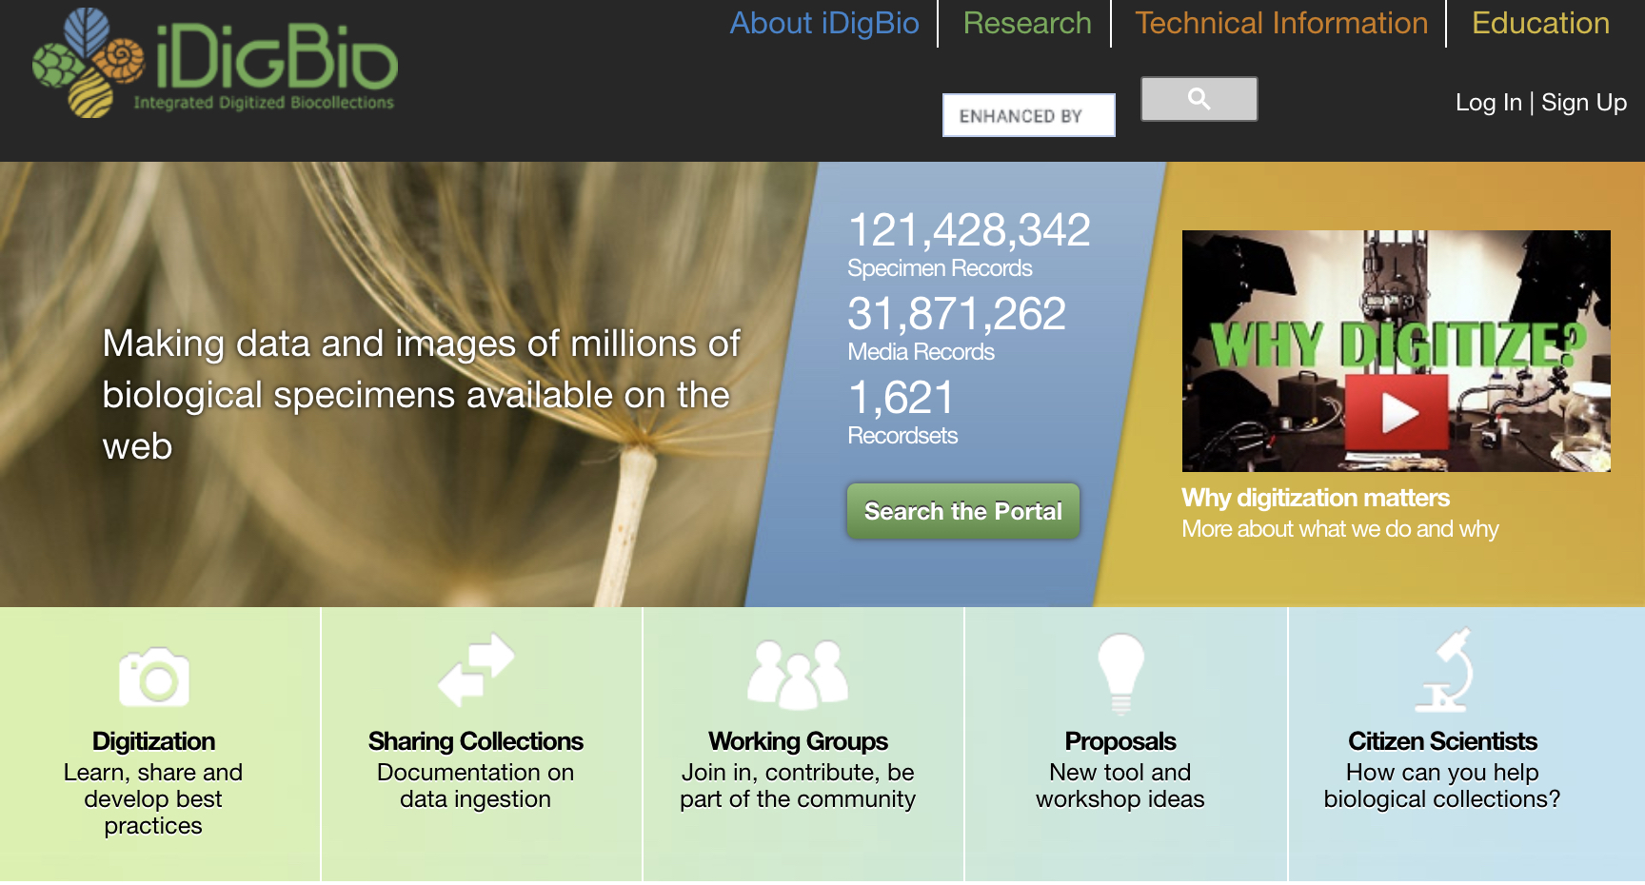
Digitized Data & Biodiversity Research
www.idigbio.org
Notes:
Current number of records—most are plants (cheering)

Slide 8
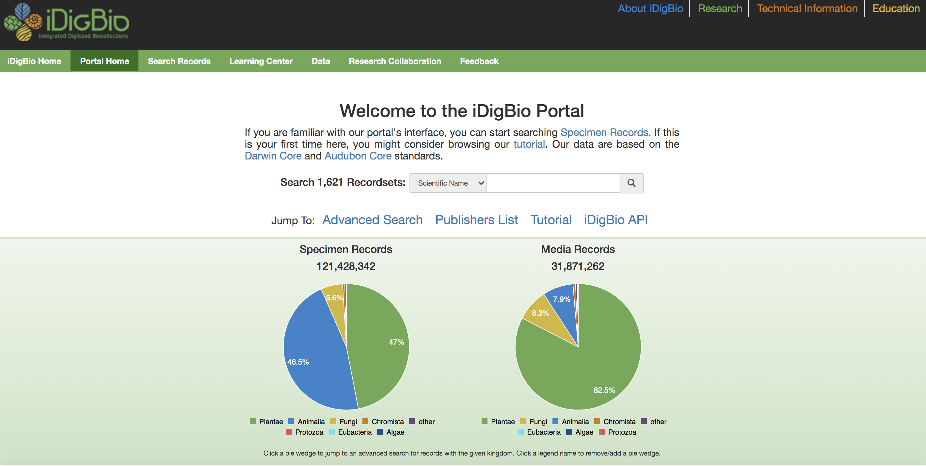
Digitized Data & Biodiversity Research
www.idigbio.org
Notes:
Current number of records—most are plants (cheering)

Slide 9
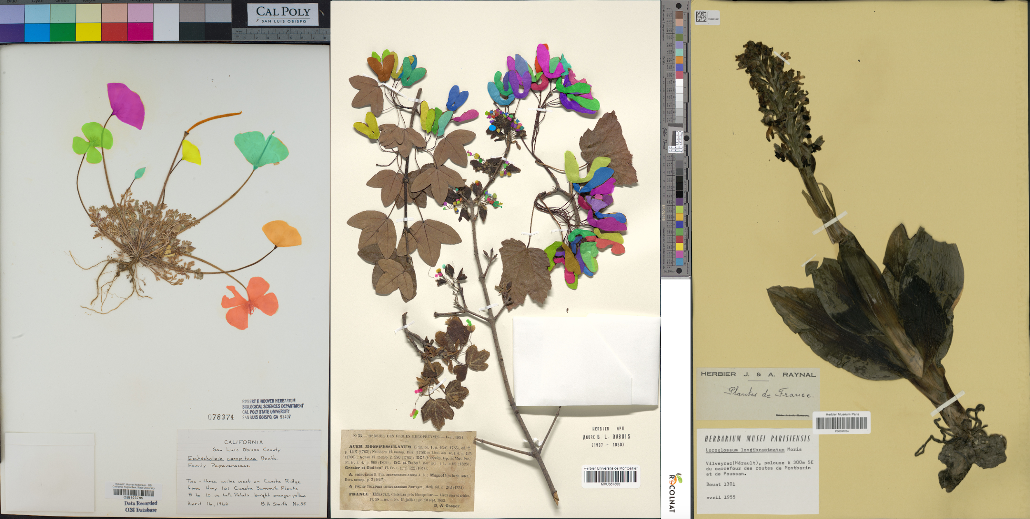
Machine Learning & Biodiversity Research
Pearson et al. 2020
Carranza-Rojas et al. 2017
Notes:
Current number of records—most are plants (cheering)

Slide 10
Machine Learning & Biodiversity Research
June: Herbarium Specimen Images
Phenology (2)
Morphology
Herbivory
Species Identification (2)
Software: Leaf Detection
Software: Leaf Recognition and Measurement
Edited by P. Soltis, G. Nelson, A. Zare, E. Meineke
Notes:
Current number of records—most are plants (cheering)

Slide 11
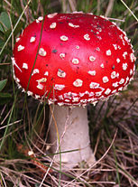
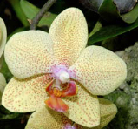
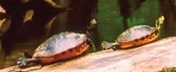
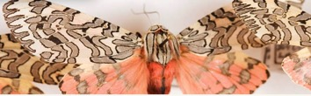
‘Big Data’ Research in Biodiversity Science
Monitoring shifts in biodiversity
Tracking invasive species
Ecological Niche Modeling, climate change
Past movements and climate change
Tracking phenological shifts
Landscape genetics
Integration of ENM with phylogeny
Community phylogenetics/assembly
Biogeography
Notes:
Some examples of these research themes – again with masses of data and integrated across groups of organisms, such as plants, vertebrates, invertebrates, and fungi – are listed here. And I’ll note that in addition to the traditional museum specimen, more and more museums are developing DNA and tissue collections as well (as we have). In addition, DNA can often be extracted from the museum specimen itself. DNA samples allow researchers to integrate spatial and genetic variation in the field known as landscape genetics.

Slide 12
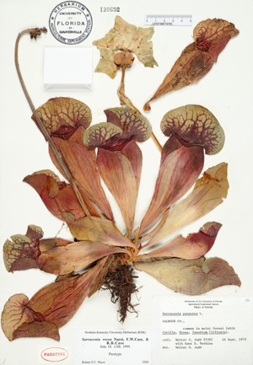
Label Data from Herbarium Specimens
Scientific name –
including authority
Date
Collector
Location – state, county,
specific site,
GPS coordinates
Associated species
Notes
Notes:
There is so much information on a label--expound

Slide 13
Overview of Day’s Activities
10:00 10:15 10:30 10:50 11:05 11:35 12:00 12:15 12:30 1:00 1:30 2:00 2:15 2:30 2:50 3:10 3:30 3:50 4:15 4:30 4:45 5:00 | Welcome and Overview of the Workshop – Pam iDigBio Portal – Pam Data Downloads – Lauren Break Data Cleaning – Shelly Georeferencing – Andre Break Climate Processing – Andre Climatic Niche – Shelly Lunch Question Session Applications of ENMs – Pam Ecological Niche Models – Maria Interpreting ENM Results – Maria Post-ENM analysis – Shelly Question Session Break Phylogenetic Diversity – Doug/Maria Intro to BiotaPhy – Doug BiotaPhy – Maria Question Session End
Notes:
Here is our outline of activities

Slide 14
Specimen Localities in iDigBio

Slide 15
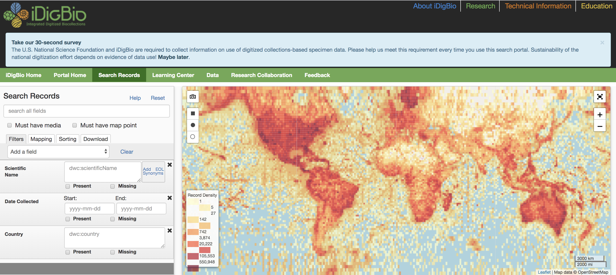
Search Specimen Records

Slide 16
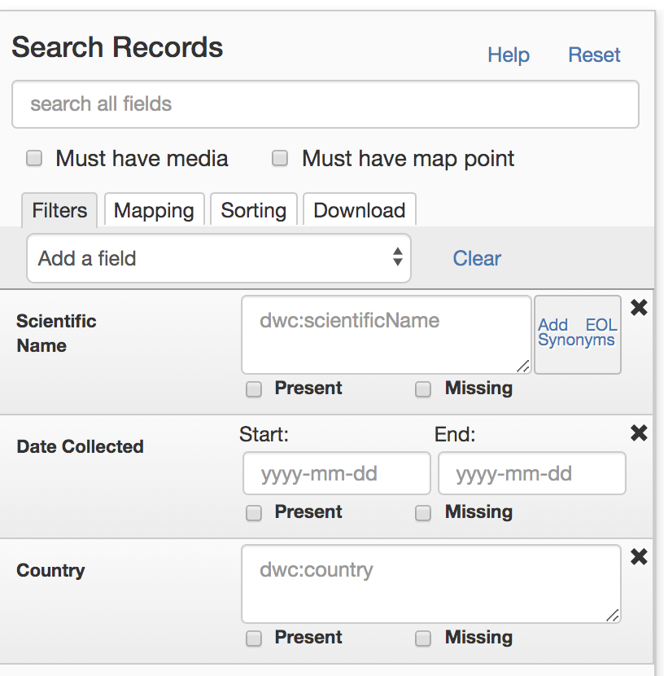
Search Specimen Records

Slide 17
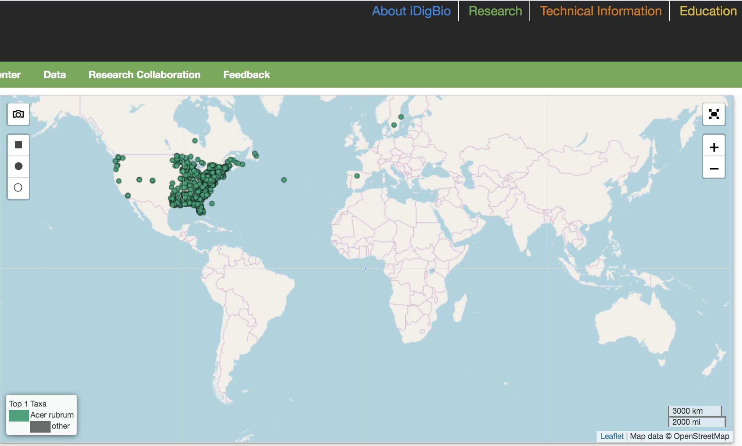
Search Specimen Records

Slide 18
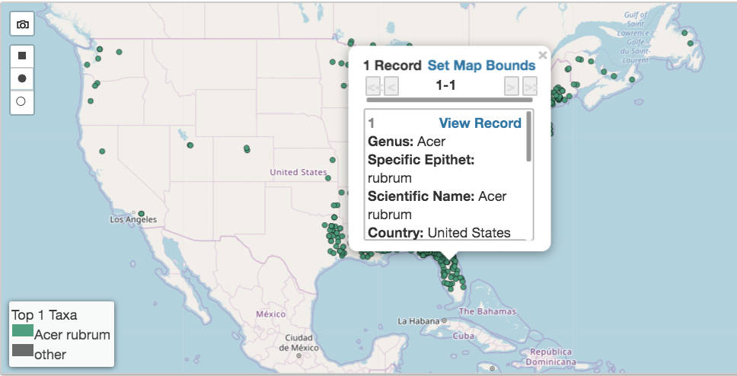
Search Specimen Records

Slide 19
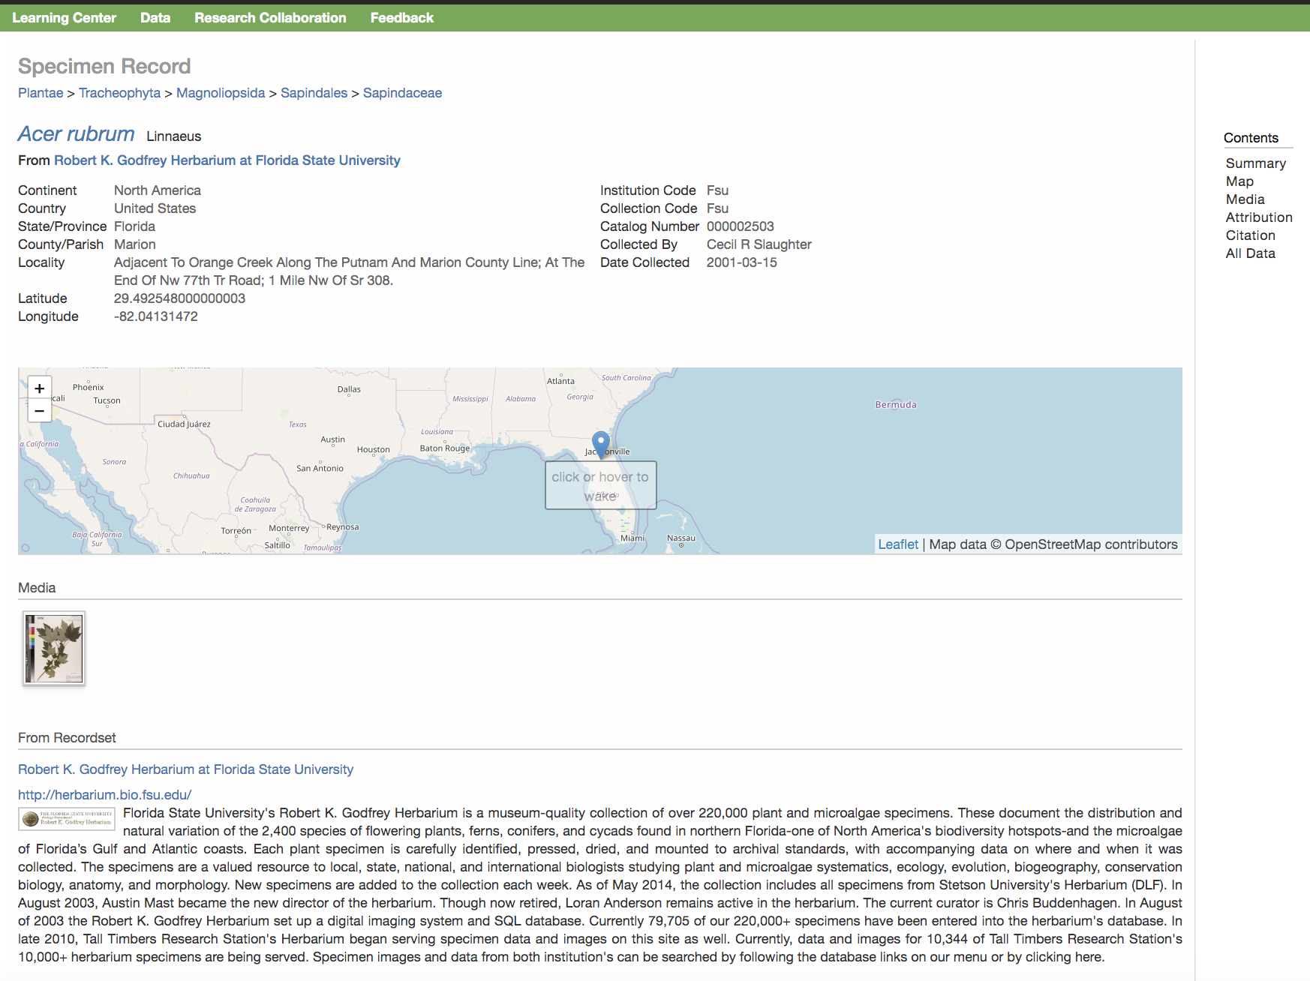
Search Specimen Records

Slide 20
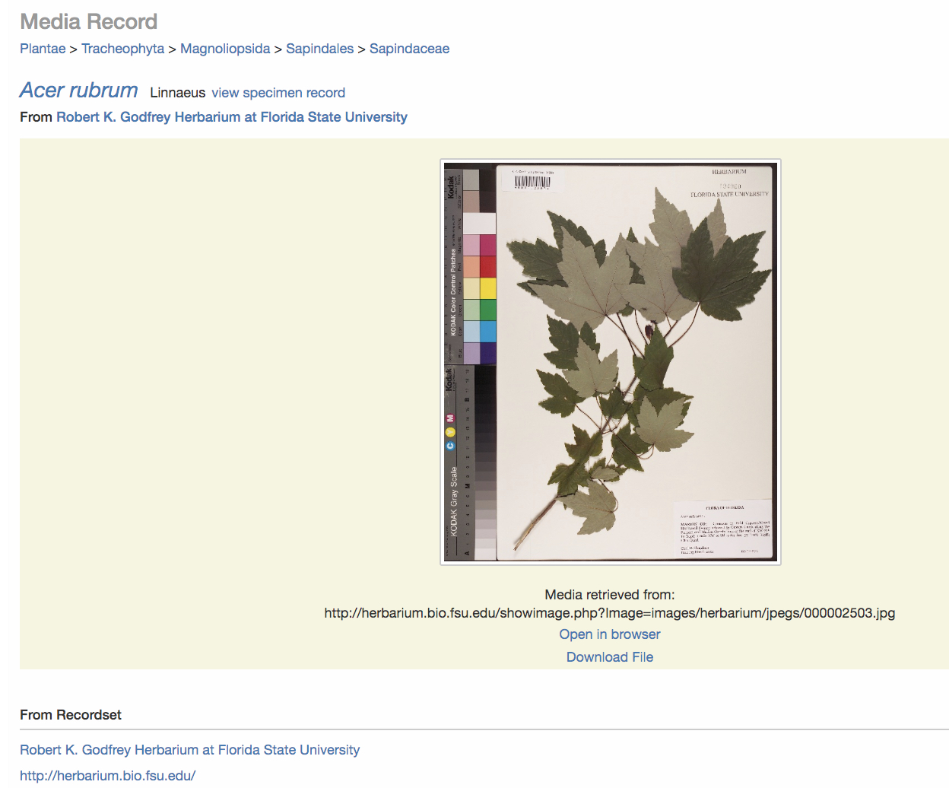
Search Specimen Records

